Slide 1
Module B
Unit B1
Vocabulary
Language Functions
Speaking Activities
UTN FRVM Lic. Evangelina Cecchel - Lic. Bibiana Fernandez

Slide 2
Language functions:
Talking about actions in progress in the past
Expressing degrees of certainty
UTN FRVM Lic. Evangelina Cecchel - Lic. Bibiana Fernandez

Slide 3
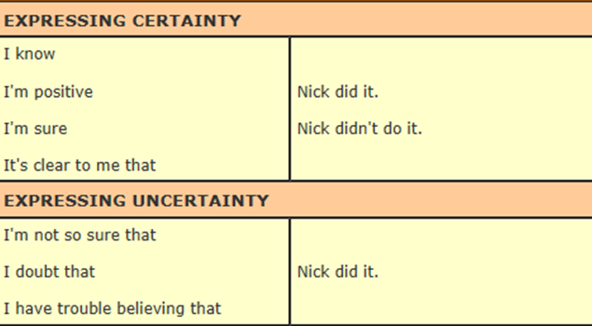
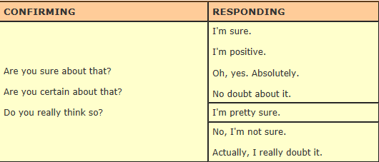
UTN FRVM Lic. Evangelina Cecchel - Lic. Bibiana Fernandez

Slide 4
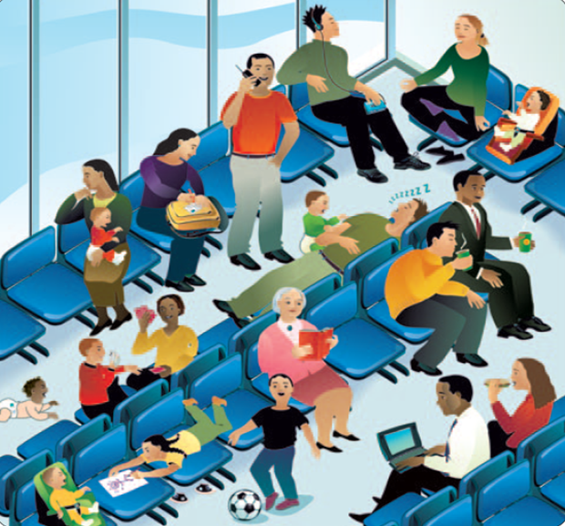
What were these people doing at the airport
when you arrived?
UTN FRVM Lic. Evangelina Cecchel - Lic. Bibiana Fernandez

Slide 5
Are you sure you know?
Argentina Statistics
Capital:
Population:
Total Area: Currency:
National flower:
National dance:
Typical food:
Highest mountain:
Widest river:
National sport:
Most popular sport:
UTN FRVM Lic. Evangelina Cecchel - Lic. Bibiana Fernandez

